Slide 1
Single Shot detector
Purva Chiniya
IIT Roorkee
Motto:Striving to win

Slide 2
Dataset :
Pascal VOC 2007 and Pascal VOC 2012 for training
PASCAL VOC 2007 trainval for validation
PASCAL VOC Test 2007 for evaluation
Model and Weights:
Training is done using VGG16 model as in the paper
ILSVRC weights has been used as in the original model.

Slide 3
Paper : SSD
Single Shot: this means that the tasks of object localization and classification are done in a single forward pass of the network
MultiBox: this is the name of a technique for bounding box regression developed by Szegedy et al.
Detector: The network is an object detector that also classifies those detected objects

Slide 4
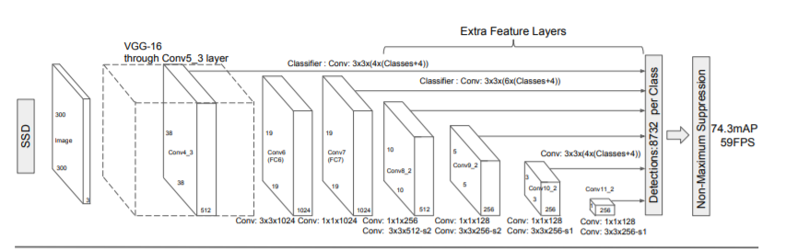
Architecture:

Slide 5
SSD’s architecture builds on the venerable VGG-16 architecture, but discards the fully connected layers.
The reason VGG-16 was used as the base network is because of its strong performance in high quality image classification tasks and its popularity for problems where transfer learning helps in improving results.
Instead of the original VGG fully connected layers, a set of auxiliary convolutional layers (from conv6 onwards) were added, thus enabling to extract features at multiple scales and progressively decrease the size of the input to each subsequent layer.

Slide 6
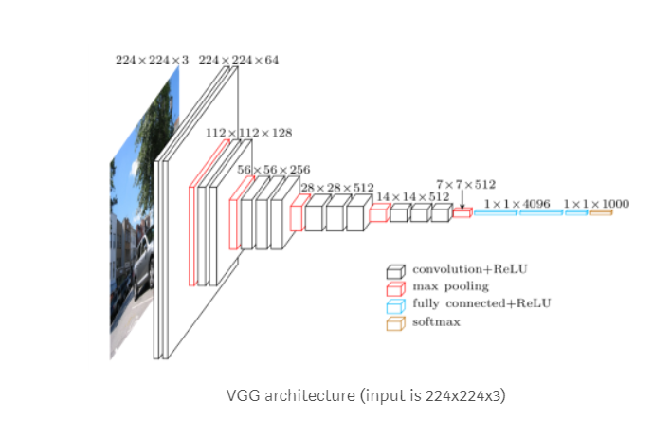
Model Architecture:

Slide 7
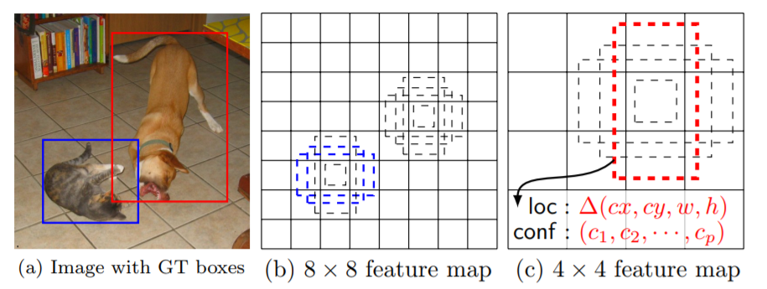
Every feature map cell is associated with a set of default bounding boxes of different dimensions and aspect ratios. These priors are manually (but carefully) chosen, whereas in MultiBox, they were chosen because their IoU with respect to the ground truth was over 0.5. This in theory should allow SSD to generalise for any type of input, without requiring a pre-training phase for prior generation. For instance, assuming we have configured 2 diagonally opposed points (x1, y1) and (x2, y2) for each b default bounding boxes per feature map cell , and c classes to classify, on a given feature map of size f = m * n, SSD would compute f * b * (4 + c) values for this feature map.

Slide 8
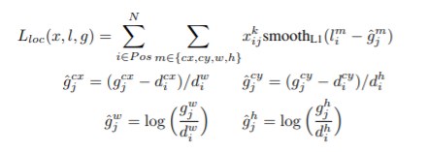
Location Loss:
SSD uses smooth L1-Norm to calculate the location loss. While not as precise as L2-Norm, it is still highly effective and gives SSD more room for manoeuvre as it does not try to be “pixel perfect” in its bounding box prediction (i.e. a difference of a few pixels would hardly be noticeable for many of us).

Slide 9
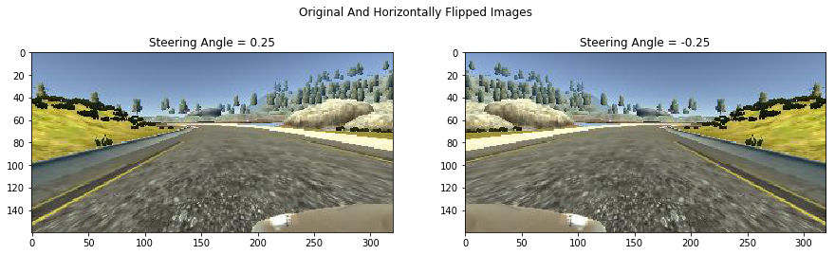
Data Augmentation
The authors of SSD stated that data augmentation, like in many other deep learning applications, has been crucial to teach the network to become more robust to various object sizes in the input. To this end, they generated additional training examples with patches of the original image at different IoU ratios (e.g. 0.1, 0.3, 0.5, etc.) and random patches as well. Moreover, each image is also randomly horizontally flipped with a probability of 0.5, thereby making sure potential objects appear on left and right with similar likelihood.

Slide 10
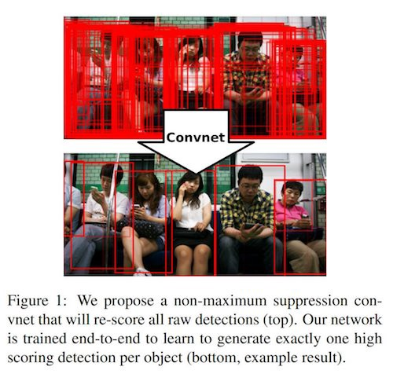
Non-Maximum Suppression (NMS)
Given the large number of boxes generated during a forward pass of SSD at inference time , it is essential to prune most of the bounding box by applying a technique known as non-maximum suppression: boxes with a confidence loss threshold less than ct (e.g. 0.01) and IoU less than lt (e.g. 0.45) are discarded, and only the top N predictions are kept. This ensures only the most likely predictions are retained by the network, while the more noisier ones are removed

Slide 11
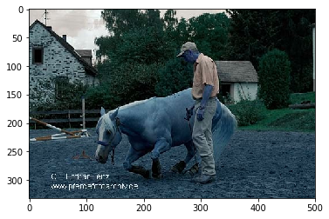
Input Image:

Slide 12
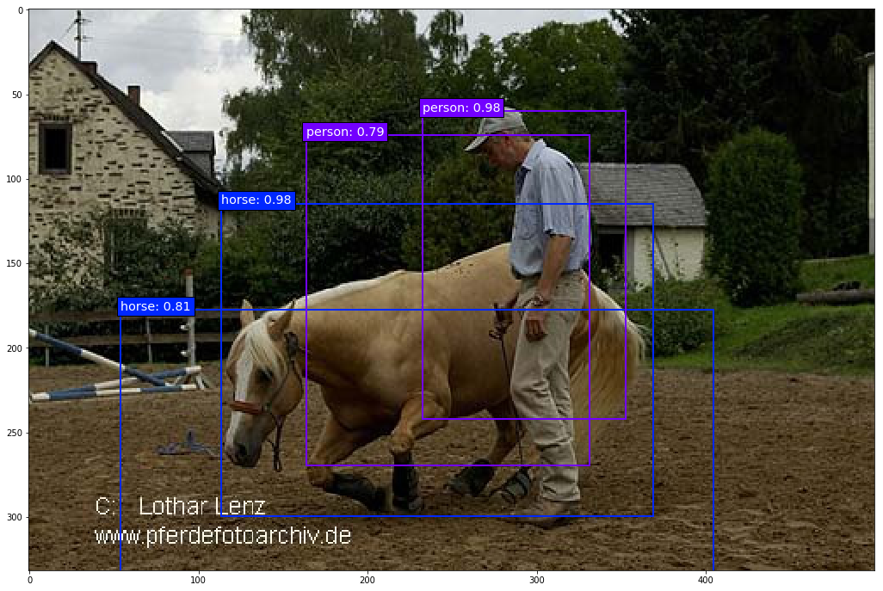
Output of the model:

Slide 13
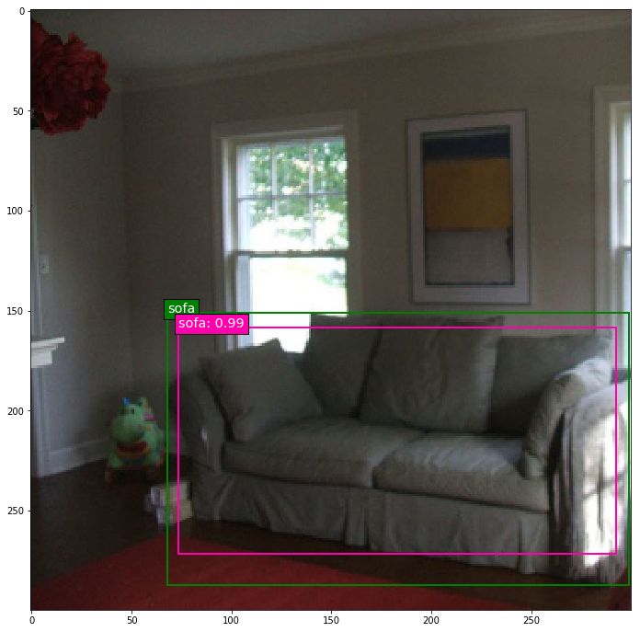
#Training Output

Slide 14
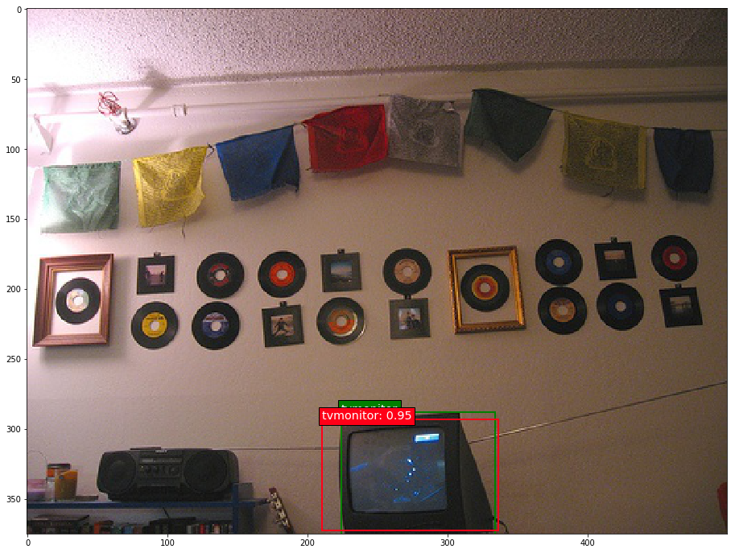

Slide 15
Predictions:
Output on voc test dataset is stored in repo.
Original documentation of challenge uses matab code on these files to compute accuracy and map score.

